Slide 1
Database Systems
Lecture 11
Refining the ER design for the company database, ER diagrams, naming conventions, Alternative Notations for ER diagrams and designs Issues, Examples of other Notations

Slide 2
Today’s agenda
Refining the ER Diagram
Proper Naming for Schema Constructs
Alternative Notation for ER Diagram
UML Class Diagram for Company Database

Slide 3
Refining the ER Diagram for Company Database
1. MANAGES, a 1:1 relationship type between EMPLOYEE and DEPARTMENT. EMPLOYEE participation is partial. DEPARTMENT participation is not clear from the requirements. We question the users, who say that a department must have a manager at all times, which implies total participation. The attribute StartDate is assigned to this relationship type.
2. WORKS_FOR, a 1: N relationship type between DEPARTMENT and EMPLOYEE. Both participations are total.

Slide 4
Refining the ER Diagram for Company Database
3. CONTROLS, a 1:N relationship type between DEPARTMENT and PROJECT. The participation of PROJECT is total, whereas that of DEPARTMENT is determined to be partial, after consultation with the users indicates that some departments may control no projects.
4. SUPERVISION, a 1:N relationship type between EMPLOYEE (in the supervisor role) and EMPLOYEE (in the supervisee role). Both participations are determined to be partial, after the users indicate that not every employee is a supervisor and not every employee has a supervisor.

Slide 5
Refining the ER Diagram for Company Database
5. WORKS_ON, determined to be an M:N relationship type with attribute Hours, after the users indicate that a project can have several employees working on it. Both participations are determined to be total.
6. DEPENDENTS_OF, a l:N relationship type between EMPLOYEE and DEPENDENT, which is also the identifying relationship for the weak entity type DEPENDENT. The participation of EMPLOYEE is partial, whereas that of DEPENDENT is total.

Slide 6
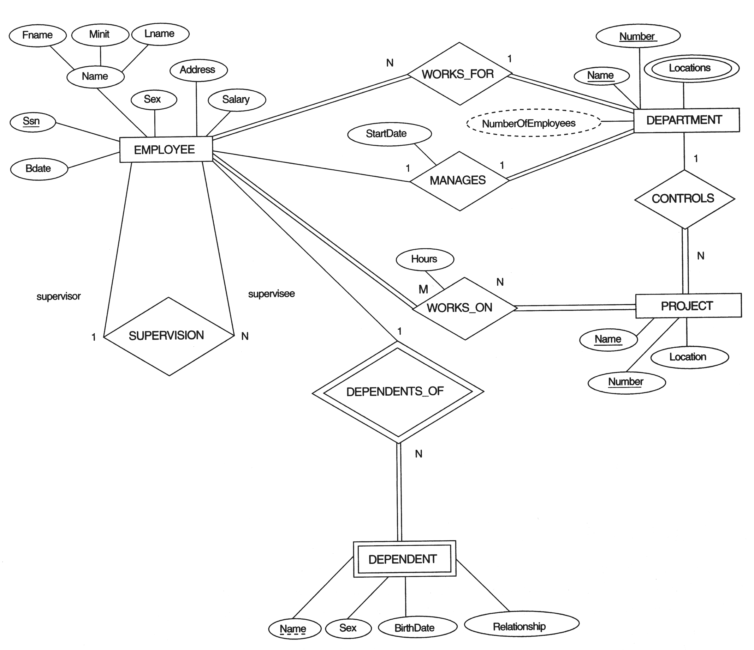

Slide 7
Proper Naming of Schema Constructs
The choice of names for entity types, attributes, relationship types, and (particularly) roles is not always straightforward.
Singular names for entity types,
Entity type and relationship type names are in uppercase letters,
Attribute names have their initial letter capitalized,
Role names are in lowercase letters
Entity type as noun
Relationship type as verb
Additional noun for attributes names

Slide 8
Alternative Notations for ER Diagram
Alternative ER notation for specifying structural constraints on relationships
This notation involves associating a pair of integer numbers (min, max) with each participation of an entity type E in a relationship type R, where 0 <= min <= max and max >= 1
In this method, min = 0 implies partial participation, whereas min > 0 implies total participation.

Slide 9
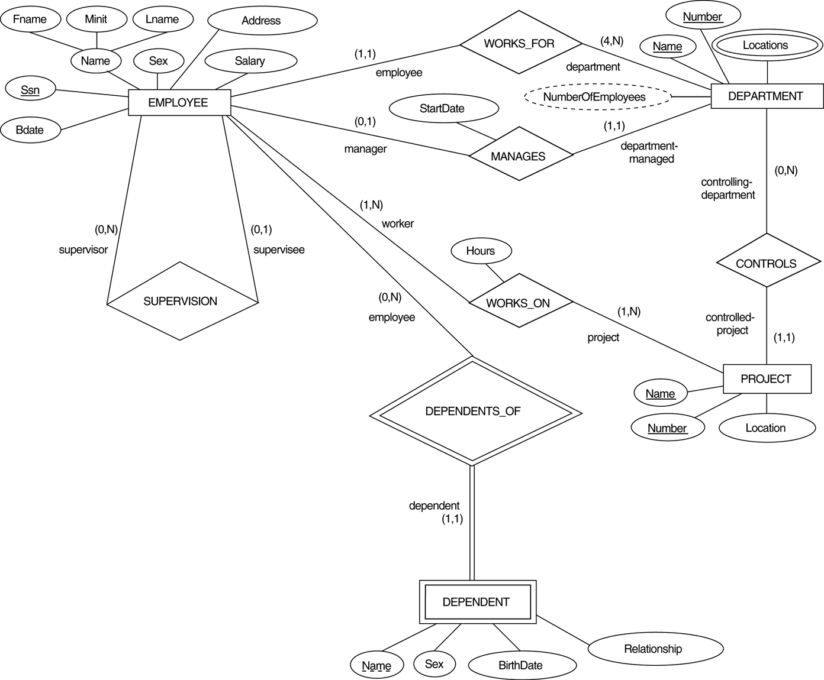
ER diagrams for the COMPANY schema, with structural constraints specific using (min, max) notation.

Slide 10
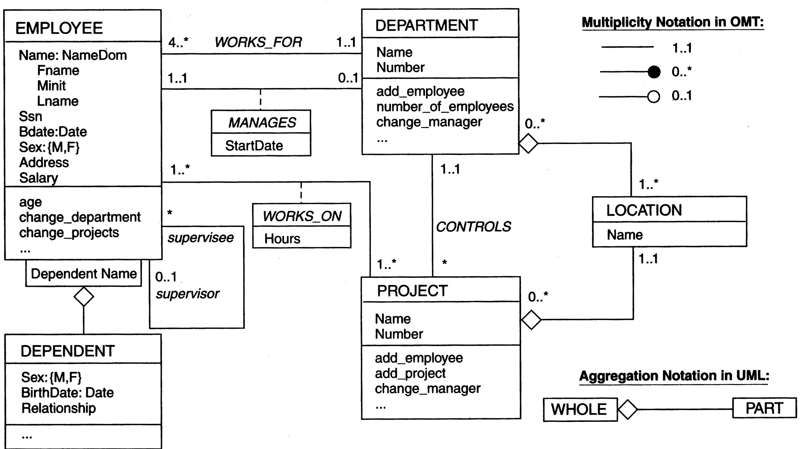
The COMPANY conceptual scheme in UML class diagram notation

